Slide 1
Class 17: Explainable and Interpretable AI
MGSC 310
Ben Labaschin

Slide 2
Class 17: Outline
Why Model Interpretability
Local and Global Model Interpretability
Feature Importance
Explainable RFs Lab

Slide 3





Why Do We Care About Explainable AI?
Consequential decisions may need human validation
Explaining the model may help us build better models
Explainable models might engender more trust

Slide 4
What Is Model Interpretability?
Model interpretability:
“the degree to which a human can understand the cause of a decision” (Miller, 2017)
The higher the interpretability, the easier it is for someone to comprehend why a decision has been made
High Interpretability Models
Linear and smooth relationships
Easy to compute
Few observations okay
Linear regression (OLS)
More interpretable
Decision Trees
Low Interpretability Models
Non-linear relationships
Non-smooth relationships
Need many observations
Long computation time
Interpretability
Random Forests
Neural Networks
Less interpretable
Deep Neural Networks
Less accurate
Accuracy
More accurate

Slide 5
Interpreting Linear Model Coefficients
Linear model are easy to interpret because the impact of any predictor is the same, regardless of the range of X that we consider
This is not the case for non-linear models.
For ensemble models the problem is all the more difficult because we have many models to consider, each of which may be different
So how do we interpret non-linear ensemble models?

Slide 6


How Does a Computer Vision Model Detect Objects?
Source: https://rocknrollnerd.github.io/ml/2015/05/27/leopard-sofa.html

Slide 7

How Does a Computer Vision Model Detect Objects?
Source: https://rocknrollnerd.github.io/ml/2015/05/27/leopard-sofa.html

Slide 8

Well, What Will Happen Here?
Source: https://rocknrollnerd.github.io/ml/2015/05/27/leopard-sofa.html

Slide 9
Not Great, Bob
Source: https://rocknrollnerd.github.io/ml/2015/05/27/leopard-sofa.html

Slide 10

Vizualizing heatmap to discover what part of an image results in the classification of elephants
Notes:
“In particular, it’s interesting to note that the ears of the elephant calf are strongly activated: this is probably how the network can tell the difference between African and Indian elephants.

Slide 11

What Does Your Model Do Out of Domain?
Models often learn “shortcuts” rather than general rules
By testing your model in novel scenarios we can see whether its actually learning
https://www.lakera.ai/insights/the-computer-vision-bias-trilogy-shortcut-learning

Slide 12
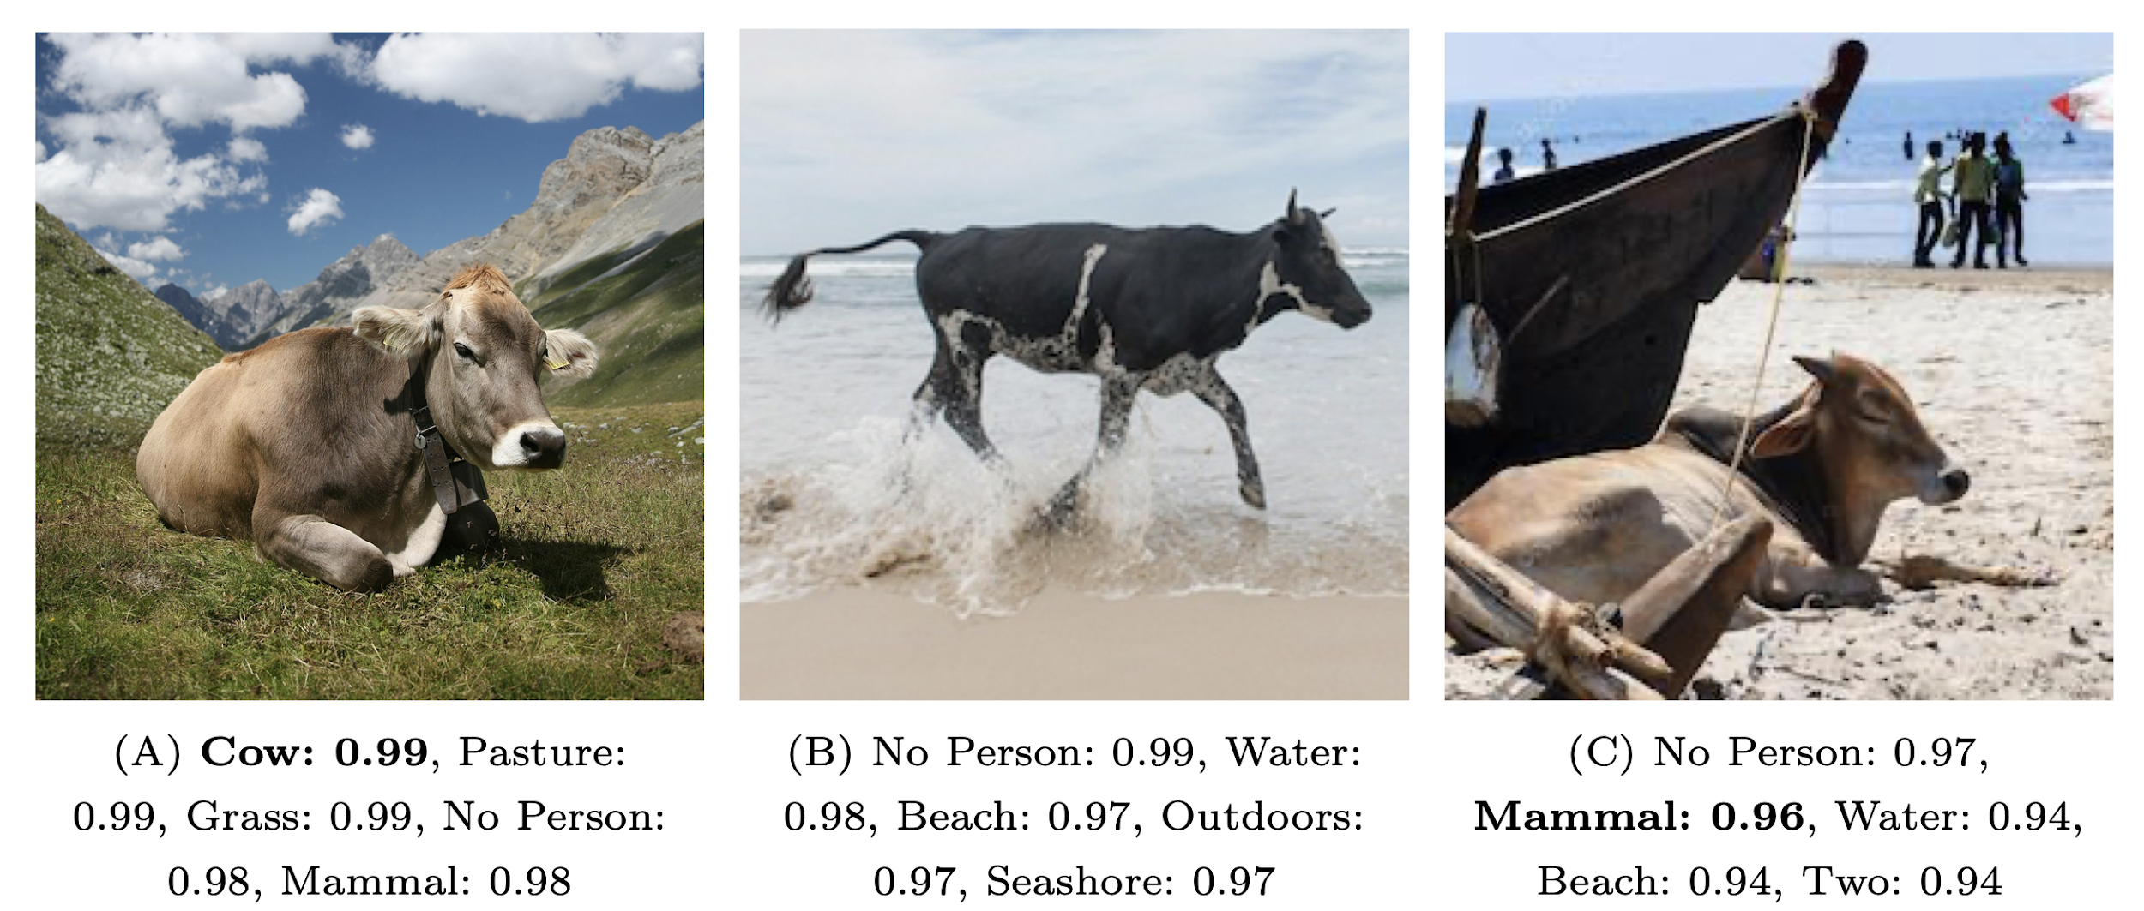
Avoiding Shortcut Learning
Models have improved since then, but the lesson for ML is clear: avoid shortcut learning
How? Test prediction out of distribution!
I.e. how does the model perform on total novel situations.
Source: https://rocknrollnerd.github.io/ml/2015/05/27/leopard-sofa.html

Slide 13
Class 17: Outline
Why Model Interpretability
Local and Global Model Interpretability
Feature Importance
Explaining Random Forests with Random Forest Explainer
Explainable RFs Lab

Slide 14


Local and Global Interpretability
Global Interpretability refers to methods that help understand why a model or algorithm makes certain decisions on average. Global interpretability is based on a holistic view of variables, parameters and structure of the model.
Local Interpretability refers to methods that zoom in on a particular observation and explain why the algorithm chose a result for that specific observations.

Slide 15
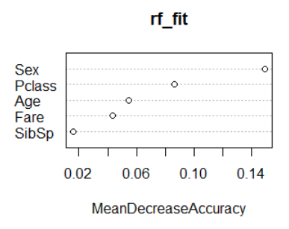
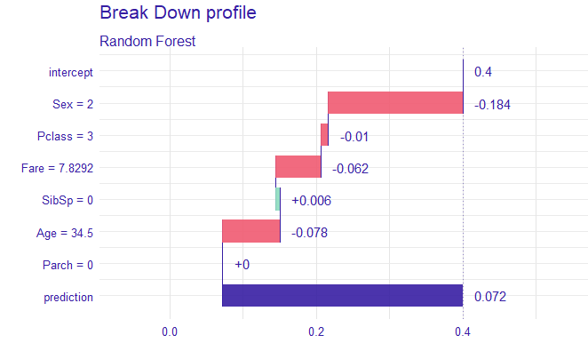
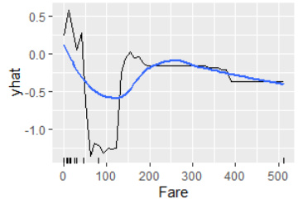
What is Explainable AI?
Maybe our models are too complicated? Angelino, Larus-Stone, Alabi, Seltzer, and Rudin. Learning Certifiably Optimal Rule Lists for Categorical Data. JMLR, 2018. https://youtu.be/sl78EgrT4TY
Explainable AI is artificial intelligence where an extra step has been taken such that the computer’s decisions can be understood by a human
Often start with a black box model and ask computer to “explain”
Global feature importance
(Which variables drive the results)
Local feature importance
(Explain prediction for a given obs)
Variable Importance
Partial dependence
Shapley plots

Slide 16
AI “Dashboards” Are Often Employed to Explain Predictions
https://github.com/MAIF/shapash

Slide 17
Class 17: Outline
Why Model Interpretability
Local and Global Model Interpretability
Feature Importance

Slide 18
Global Interpretability: Permutation Feature Importance
To the code!

Slide 19
Global Interpretability: Partial Dependence Plots (PDPs)
To the code!

Slide 20

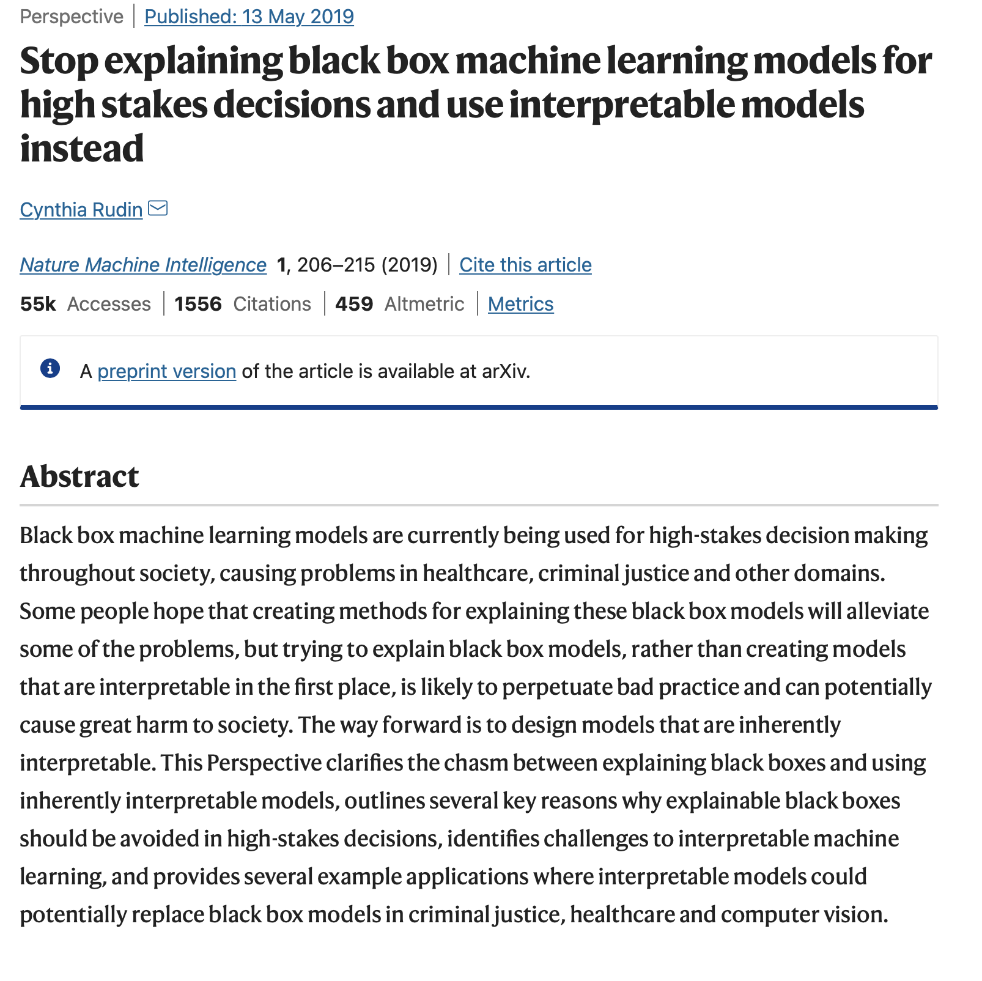
Counterpoint From Cynthia Rudin: Don’t Do This
Cynthia’s Point: Use Simple, Interpretable Models Instead of Complex, Explainable Ones
Not clear which approach is best
https://youtu.be/4oXFEDoEcAk

